Slide 1
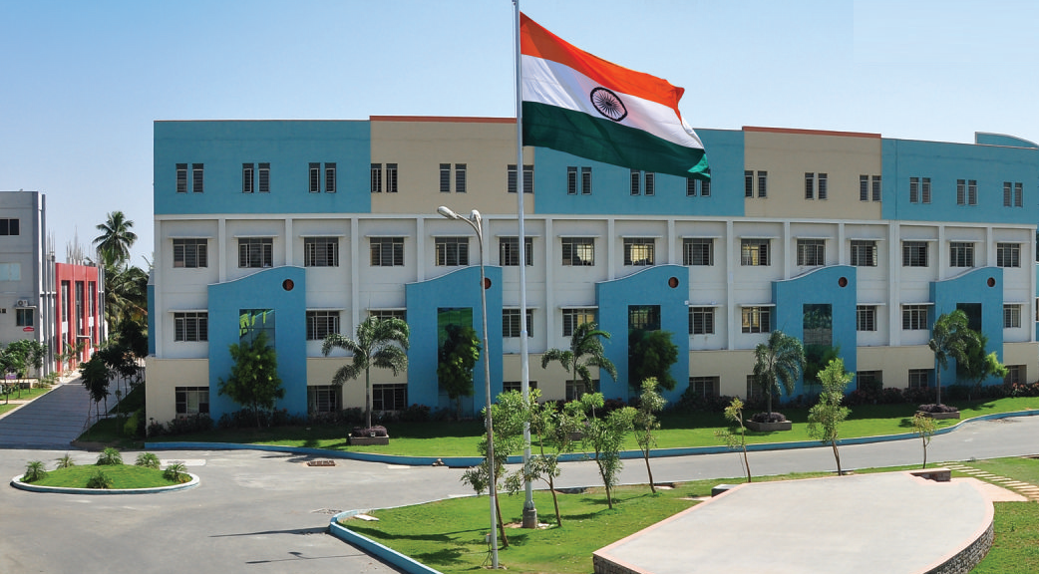
SRI ESHWAR COLLEGE OF ENGINEERING
academic year : 2017-18 department : civil section : 4 -year
FINAL YEAR PROJECT REVIEW – 1st
Date of review: 02.08.2017

Slide 2
PLANNING,ANALYSIS AND DESIGN OF POLICE STATION BUILDING
By,
S.SAMSON
T.YOGESHKUMAR
A.RAGUNATH
T.ARAVITHASAMY
GUIDED BY,
MS.S.SUTHAVIJI,
ASSISTANT PROFESSOR
SRI ESHWAR COLLEGE OF ENGINEERING

Slide 3
CONTENTS
Introduction
Study area
Literature review
Objectives
Methodology
Work plan

Slide 4
ABSTRACT
The total area of the parking is 3600sq.ft
Total height of the buliding 26000SQ is feet consisting one floor
Code books referred: IS 456-2007, IS 875.

Slide 5
INTRODUCTION
A system to enhance the police station
To efficiently design the details of police station building
To analyse the structure and their loading provisions
To manually design the details of the structure

Slide 6
Objective
To facilitate the police station users
To ensure the safety of custody
To increase the safety of people surrounding the police station
To avoid any clashes in that area

Slide 7
STUDY AREA
Our project will be implement on “othakkalmandapam”
REASON:
No other police station present in that area.
No safety ensured in that area.
people have to travel 9-10 km to reach a police station in case of emergency.

Slide 8
WORK PLAN
1 | 7/7/17 | Explain the out line of the project
2 | 21/7/17 | To visit the existing police station building to gain more information
3 | 2/8/17 | Planning, designing process to be completed
4 | 16/8/17 | 1st step of analysis process is to be started
5 | 11/9/17 | Analysis process is to be completed
6 | 27/9/17 | To explain the entire project
7 | 20/10/17 | To submit the project book
8 | 28/10/17 | Final review

Slide 9
METHODOLOGY
By using “Auto CAD” software planning and designing of bank.
By using “STAAD Pro.” software analyzing of bank.

Slide 10
QUERIES??...

